Slide 1

Audio Dog Bark Identification A Machine Learning Approach
Introduction to Machine Learning featuring Prof. Musco
A Hot Dawg Presentation by: Pawel Juda and Bryan Khuu

Slide 2
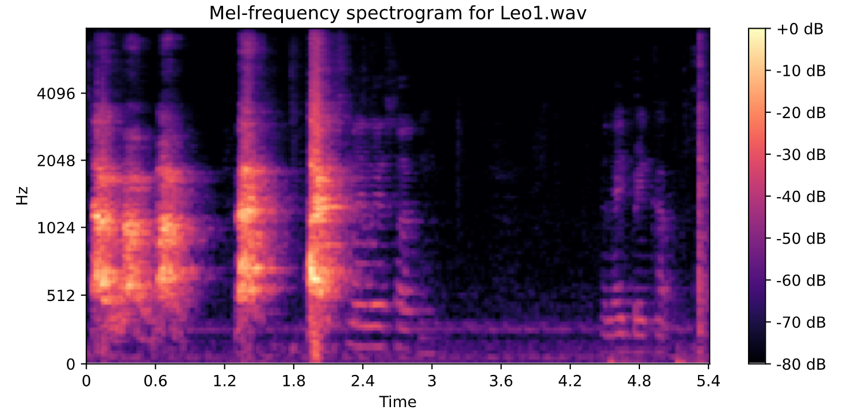
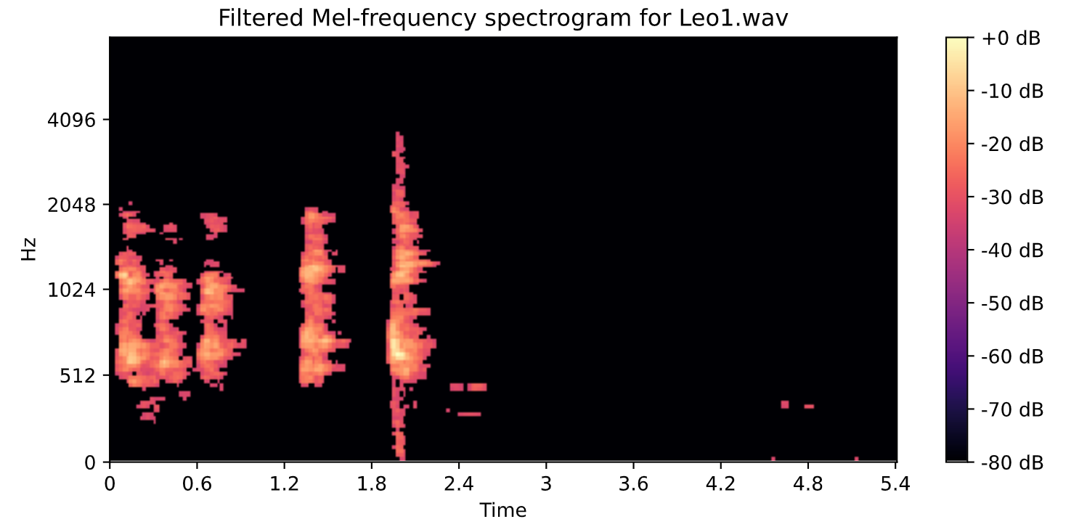
Dataset Sourcing And Pre-Processing
Sourcing:
Online Source : Kaggle https://www.kaggle.com/mmoreaux/audio-cats-and-dogs
Live Source : Household Dog - Bichon Frise Breed
Pre-processing:
Noise Reduction
Edge Filter
Audio Splitting

Slide 3
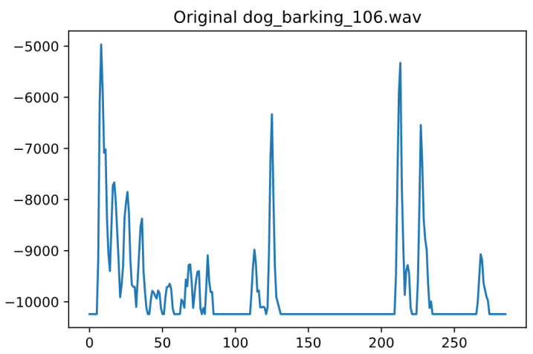
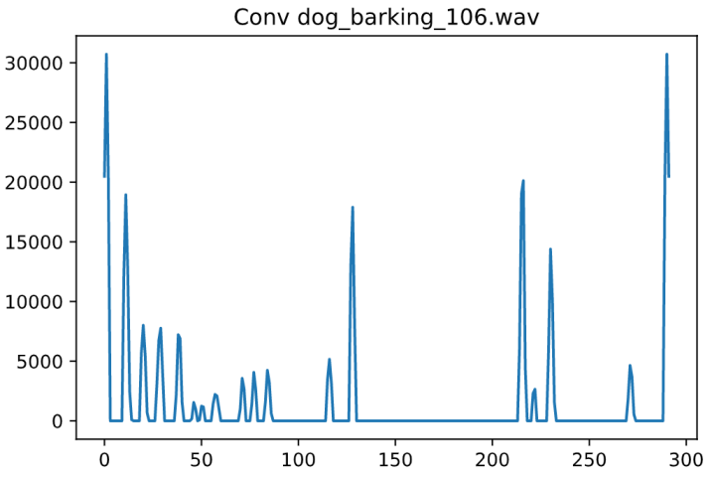
Convolutional Filtering And Bark Splicing
Convolutional Kernel Used
[ –2, –1, 1, 4, 1, –1, –2 ]

Slide 4
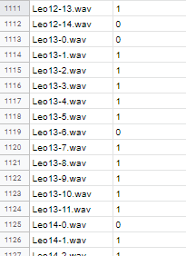
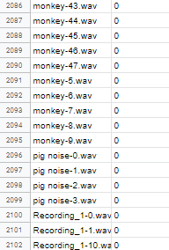
Machine Supervised Learning

Slide 5
Feature Extraction
Library Used: LibROSA
Mel-Spectrogram
Mel-Spectrogram Cepstral Coefficients
Chromagram
Zero-Crossing Rate
Root Mean Square [RMS]
Spectral Centroid
Spectral Bandwidth
Spectral Roll-off Frequency
Spectral Flatness
Spectral Contrast

Slide 6
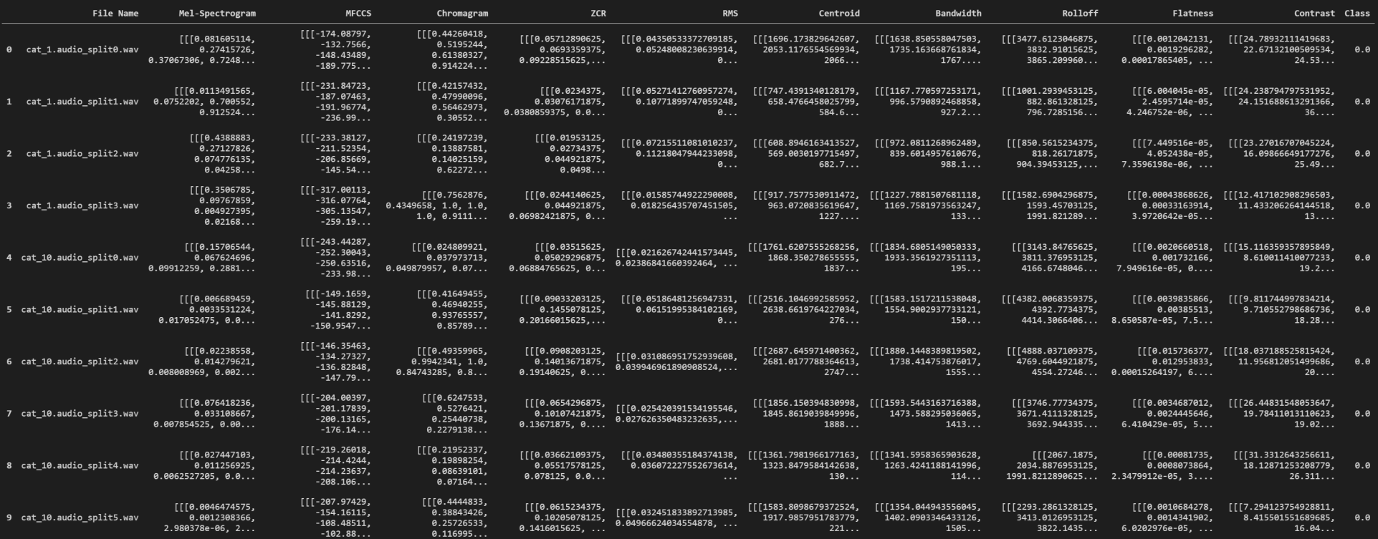
Feature Dataframe

Slide 7
Audio Classification Methods
Baseline: Logistic regression
Dogs were harmed in this presentation

Slide 8
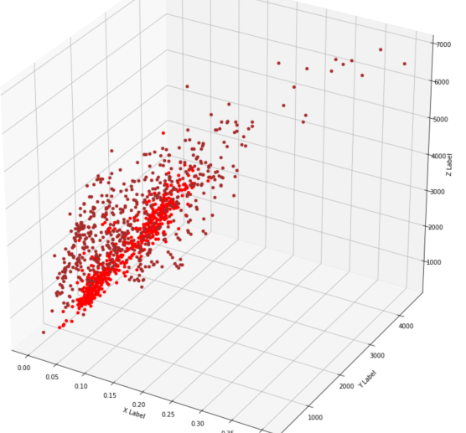
Feature Selection & visualization
Hot Dog Classifer

Slide 9
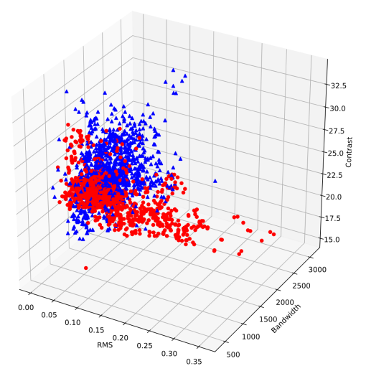
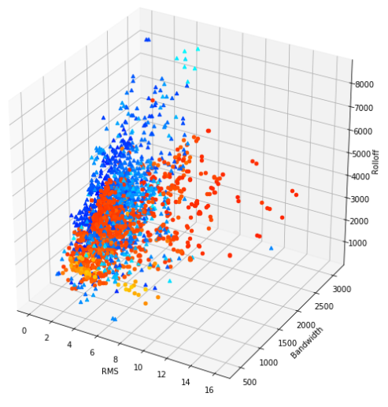
Choosing OptIMAL FEATURES
Notes:
contrast

